Slide 2
Carbonyl Condensation Reactions
The Aldol Reaction
These examples illustrate the general features of the aldol reaction. The α carbon of one carbonyl component becomes bonded to the carbonyl carbon of the other component.

Slide 3
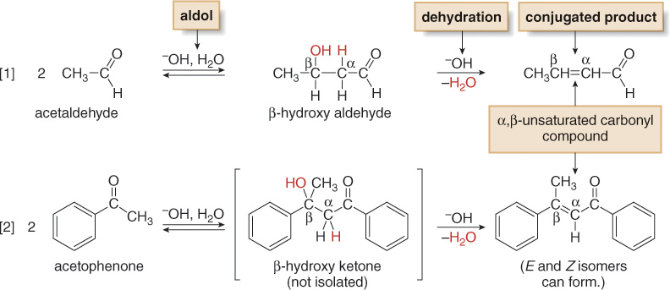
Carbonyl Condensation Reactions
The Aldol Reaction—Dehydration of the Aldol Product
Under the basic reaction conditions, the initial aldol product is often not isolated. Instead, it loses the elements of H₂O from the α and β carbons to form an α,β-unsaturated carbonyl compound.

